Slide 1


3DGATES: An Instruction-Level Energy Analysis and Optimization of 3D-Printers
Jerry Ajay, Chen Song, Aditya Singh Rathore, Chi Zhou, Wenyao Xu

Slide 2
Instruction-Level Energy Analysis
Why energy analysis for 3D Printers?
Why an instruction-level approach?

Slide 3
Emergence of Energy Constrained 3D Printers
Why energy analysis for 3D Printers?

Slide 4

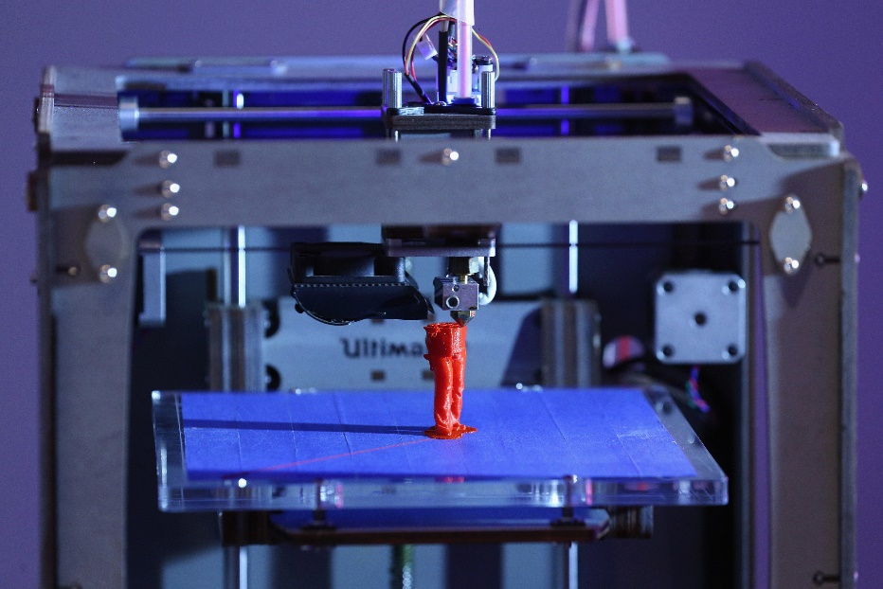

Energy Constrained 3D Printing
3D Printing Using Smartphone
http://www.ono3d.net/
3D Printing Medical Components in Remote Locations
https://www.inverse.com/article/20840-how-3d-printers-are-saving-lives-in-remote-parts-of-the-world
Energy Constrained
Made in Space Project
http://www.madeinspace.us/

Slide 5
3DGATES: An Instruction-Level Energy Analysis and Optimization of 3D-Printers
Emergence of Energy Constrained 3D Printers
Easy Energy optimizations
Why energy analysis for 3D Printers?
Why an instruction-level approach?

Slide 6

Instruction Level Energy Optimizations
Why instruction-level energy optimizations?
Independent of different H/W specifications
Compiler Level
Instr-Level
Assigns accurate power costs
to S/W
Hardware Level

Slide 7
Emergence of Energy Constrained 3D Printers
Common Interface for Energy optimizations
Why energy analysis for 3D Printers?
Why an instruction-level approach?
In this work,
1. We quantify 3D printing energy consumption.
AND
2. Identify Power Hungry components.
AND
3. Reduce energy consumption by 25%.
Original Energy
New Energy

Slide 8
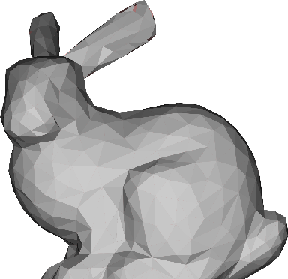
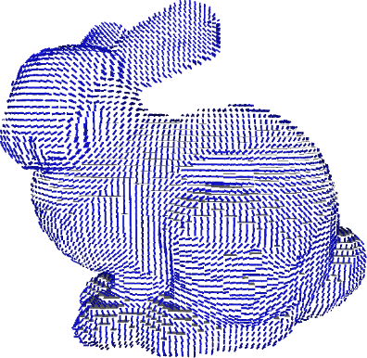


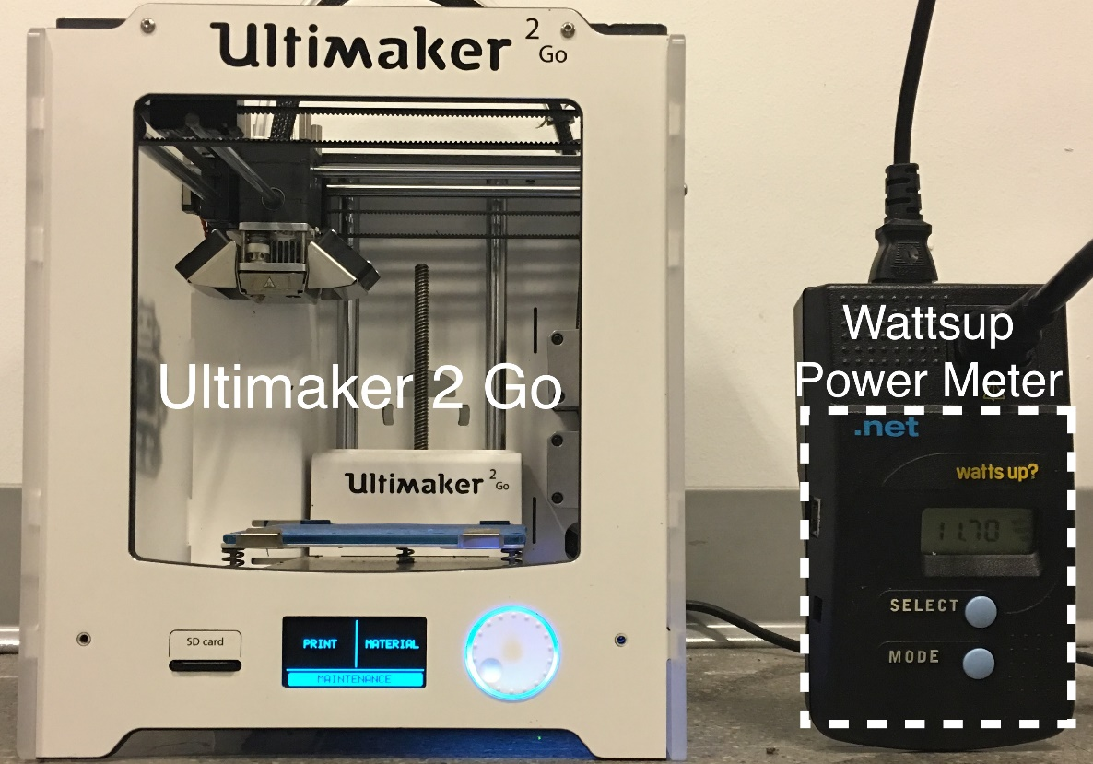



Talk Outline
1. Background
STL
G-code
Signal
Application
Layer
Compiler
Layer
Firmware
Layer
Hardware
Layer
2. Instruction-level Energy Analysis
3. Cross-layered Energy Optimizations
Instruction
Support
Firmware
Support
Compiler
Support
Square Circles
Lines
Grid
Triangles
4. Evaluation

Slide 9
Talk Outline
1. Background
STL
G-code
Signal
Application
Layer
Compiler
Layer
Firmware
Layer
Hardware
Layer
2. Instruction-level Energy Analysis
3. Cross-layered Energy Optimizations
Instruction
Support
Firmware
Support
Compiler
Support
Square Circles
Lines
Grid
Triangles
4. Evaluation

Slide 10

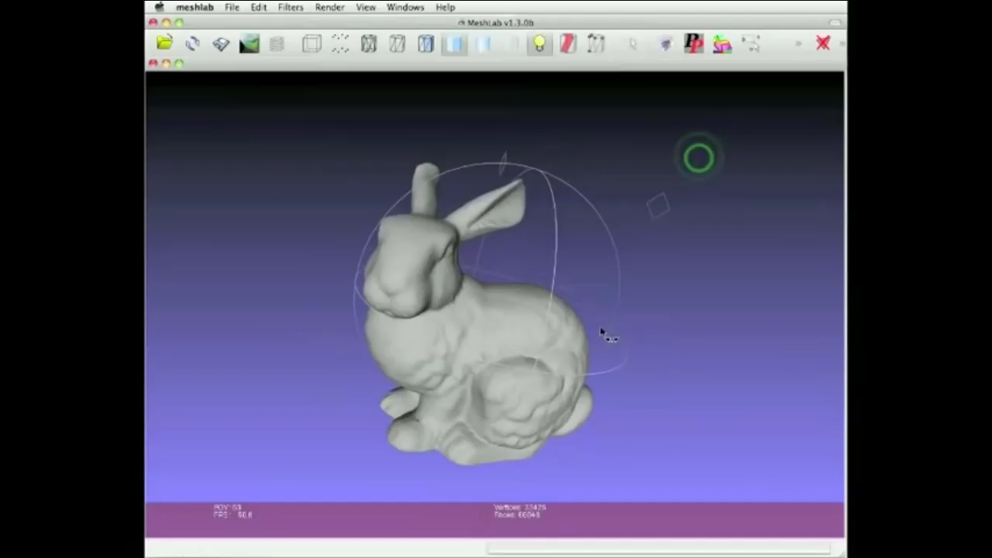
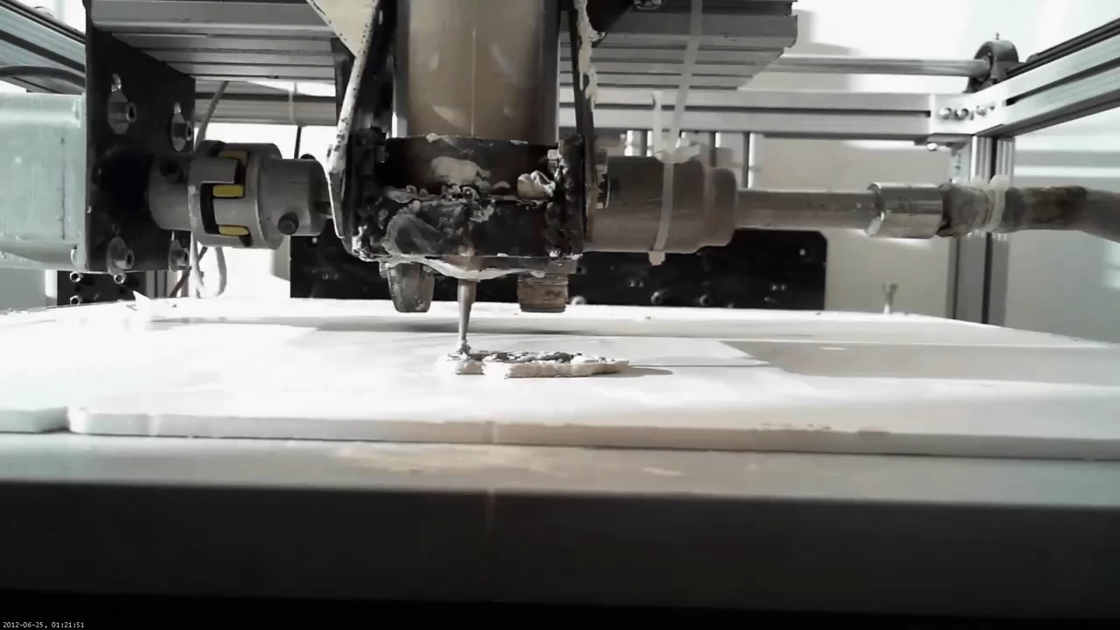
Background – 3D Printing Process
STL
G-code
Signal
Application
Layer
Compiler
Layer
Firmware
Layer
Hardware
Layer
CYBER LAYER
PHYSICAL LAYER

Slide 11
Talk Outline
1. Background
STL
G-code
Signal
Application
Layer
Compiler
Layer
Firmware
Layer
Hardware
Layer
2. Instruction-level Energy Analysis
3. Cross-layered Energy Optimizations
Instruction
Support
Firmware
Support
Compiler
Support
Square Circles
Lines
Grid
Triangles
4. Evaluation

Slide 12
Instruction Level Energy Analysis (1/5)
G-code Instructions - Overview
Instruction Distribution in a typical G-code file
Instruction Category | Count | %
G0-Type | 36184 | 13.86%
G1-Type | 224837 | 86.13%
C-Type | 5 | 0.001%
Total | 261026 | 100%
Types of G-codes:
G0-Type (Align Instructions):
Speed: 7200 mm/min
G1-Type (Material Extrusion Instructions):
Speed: 1200 – 8600 mm/min
C-Type (Control Instructions):
- Heater, Fan controls

Slide 13
Instruction Level Energy Analysis (2/5)
Infinite Looping Individual Instructions to Obtain Avg. Power
Experimental Setup to measure G-code Power Consumption
Instruction Category | Avg. Pwr. (W)
G0 7200 mm/min | 21.30
G1 1200 mm/min | 37.90
G1 3600 mm/min | 39.94
G1 5200 mm/min | 40.38
G1 8600 mm/min | 42.06
M109: Heater Temp | 31.19
M106: Fan on | 3.61
G0-Type
G1-Type
C-Type

Slide 14



Slide 15
Instruction-Level Energy Analysis (4/5)
Based on Instruction Level Energy Model we built a S/W Energy Simulator
POWER (W)
Error approx. 3%
IDLE
HEAT UP
PRINTING
COOL DOWN
Insight: An Instruction level energy simulator is accurate for energy simulations for 3D Printing.

Slide 16

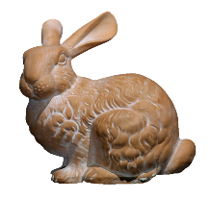

Instruction-Level Energy Analysis (5/5)
Benchmark Statistics
Simulation over 338 Designs downloaded from
www.thingverse.com – (Website offering multiple design files)
Category | # of files | # of instructions
Industrial tools | 23 | 27.2 Million
Hobby items | 34 | 16.5 Million
Household items | 19 | 5.4 Million
… | … | …
12 Categories | 338 files | 71 million instr.

Slide 17
Insights from Energy Analysis
Simulation over 338 Designs
Motors consume the
most energy; not the heaters
Insight: Power-gating the motor can drastically reduce energy consumption

Slide 18
Talk Outline
1. Background
STL
G-code
Signal
Application
Layer
Compiler
Layer
Firmware
Layer
Hardware
Layer
2. Instruction-level Energy Analysis
3. Cross-layered Energy Optimizations
Instruction
Support
Firmware
Support
Compiler
Support
Square Circles
Lines
Grid
Triangles
4. Evaluation

Slide 19



Cross-Layer Energy Reduction Approach for 3D Printers
Instruction
Support
Firmware
Support
Compiler
Support

Slide 20


Cross-Layer Energy Reduction Approach for 3D Printers (1/6)
STL
G-code
Signal
Application
Layer
Hardware
Layer
Compiler
Layer
Firmware
Layer
Re-compiler
New
G-code
Firmware Support Interface
Our Cross-
Layered Solution
S-series Instr.
Re-compiler Algorithm

Slide 21
Cross-Layer Energy Reduction Approach for 3D Printers (2/6)
Instruction Support
New S-series G-code Instructions
S-series | Function | Pwr. (W)
S X on | X-motor on | 2.39
S X off | X-motor off | 2.38
S Y on | Y-motor on | 2.40
S Y off | Y-motor off | 2.42

Slide 22
Cross-Layer Energy Reduction Approach for 3D Printers (3/6)
Instruction Support
Addition of New S-series G-code Instructions
S X off
S Y on
G1 X680.185 Y80.416 E1.15471
G1 X680.185 Y80.079 E1.24956
G1 X680.185 Y79.831 E1.33800
G1 X680.185 Y79.717 E1.38503
S Y off
S X on
G1 X682.736 Y79.717 E1.47988
G1 X683.482 Y79.717 E1.57035
G1 X683.872 Y79.717 E1.61737
G1 X684.628 Y79.717 E1.70820
S Instructions
G1 X680.185 Y80.416 E1.15471
G1 X680.185 Y80.079 E1.24956
G1 X680.185 Y79.831 E1.33800
G1 X680.185 Y79.717 E1.38503
G1 X682.736 Y79.717 E1.47988
G1 X683.482 Y79.717 E1.57035
G1 X683.872 Y79.717 E1.61737
G1 X684.628 Y79.717 E1.70820
S Instructions
Original G-code File

Slide 23
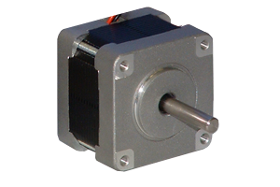
Cross-Layer Energy Reduction Approach for 3D Printers (4/6)
X Motor
Firmware Support
INV
PWM
Extension of firmware to facilitate individual motor control
Stepper Motor Driver
Enable
Y Motor
Z Motor
Significant Changes in Firmware:
In Hardware Driver Management:
- Power Gate X, Y and Z motors.
In Execution loop:
- Back-up Current Motor direction.
- Interpret new S-series instructions.
CONTROL
PWM
PWM
INV
INV
Stepper Motor Driver
UNIT
Stepper Motor Driver
Enable
Enable

Slide 24
Cross-Layer Energy Reduction Approach for 3D Printers (5/6)
Compiler Support
Incorporation of Unique Cyber-Physical Systems Properties
X-Axis
X-Axis
Y-Motor switch off
X-Motor switch on
Nozzle
Y-Axis
Y-Axis
Instruction Inertia
Instruction Delay

Slide 25
Cross-Layer Energy Reduction Approach for 3D Printers (6/6)
Re-compiling Algorithm
(Implemented in CURA Engine)
Compiler Support
S X off
S Y on
G1 X680.185 Y80.416 E1.15471
G1 X680.185 Y80.079 E1.24956
G1 X680.185 Y79.831 E1.33800
G1 X680.185 Y79.717 E1.38503
S Y off
S X on
G1 X682.736 Y79.717 E1.47988
G1 X683.482 Y79.717 E1.57035
G1 X683.872 Y79.717 E1.61737
G1 X684.628 Y79.717 E1.70820
G1 X680.185 Y80.416 E1.15471
G1 X680.185 Y80.079 E1.24956
G1 X680.185 Y79.831 E1.33800
G1 X680.185 Y79.717 E1.38503
G1 X682.736 Y79.717 E1.47988
G1 X683.482 Y79.717 E1.57035
G1 X683.872 Y79.717 E1.61737
G1 X684.628 Y79.717 E1.70820
2. Model Rotation in 2D
1. Instruction Grouping
3. S-series Insertion

Slide 26
Results of Cross-Layer Energy Reduction Approach
Reduction in Power Consumption by our Cross-Layered Approach
Instruction Category | Old Pwr. (W) | New Pwr. (W) | % Reduction
G0 7200 mm/min | 21.30 | 21.30 | -
G1 1200 mm/min | 37.90 | 24.12 | 36.4%
G1 3600 mm/min | 39.94 | 24.69 | 38.2%
G1 5200 mm/min | 40.38 | 24.54 | 39.2%
G1 8600 mm/min | 42.06 | 26.90 | 36.0%
M109: Heater Temp | 31.19 | 31.19 | -
M106: Fan on | 3.61 | 3.61 | -

Slide 27
Talk Outline
1. Background
STL
G-code
Signal
Application
Layer
Compiler
Layer
Firmware
Layer
Hardware
Layer
2. Instruction-level Energy Model
3. Cross-layered Energy Optimizations
Instruction
Support
Firmware
Support
Compiler
Support
Square Circles
Lines
Grid
Triangles
4. Evaluation

Slide 28
Evaluation
Benchmark
338 Benchmark files
71 million lines of G-code
Evaluation on four in-fill patterns
Square Circles
Lines
Grid
Triangles

Slide 29
Evaluation
Average energy reduction : 25%
Avg. 25%

Slide 30
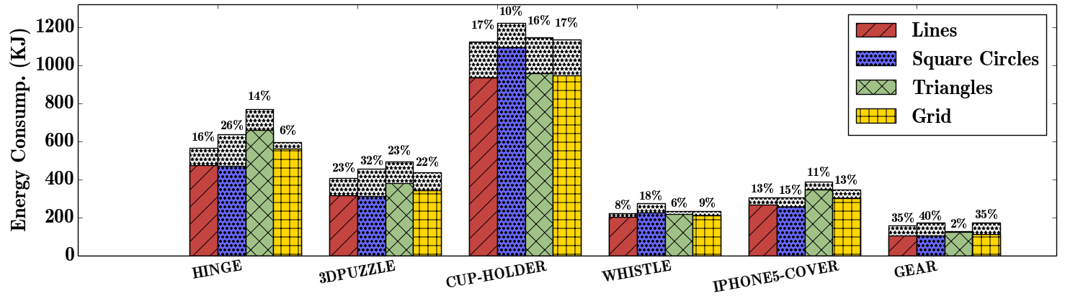
Evaluation
Sensitivity of different in-fill patterns
(6 prints on real printer)
Insight: Square Circles in-fill is best pattern for power-gating

Slide 31
Evaluation
Effect on G-code File Size
Effect on Print Duration
Max. 2%
Insight: No increase in storage
Insight: No increase in print time

Slide 32
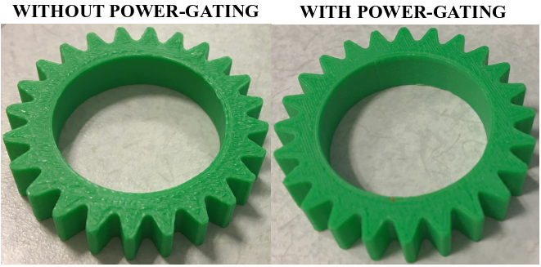
Evaluation
Above all: No Effect in Print Quality

Slide 33

Conclusion
Instruction Level Energy Analysis is viable for simulating energy consumption in 3D Printers.
Motors consume significant energy in 3D Printers.
A cross-layered software only solution reduces energy consumption by 25%.

Slide 34
Miscellaneous

Slide 35
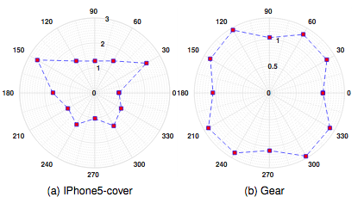
Miscellaneous
Energy Consumption at different orientations in 2D

Slide 36
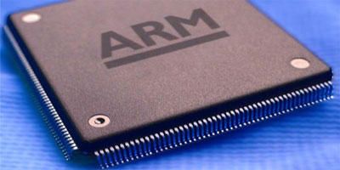


Instruction Level Energy Studies
An accurate instruction-level energy consumption model for embedded RISC processors
ACM SIGPLAN 2001.
Instruction level power analysis and optimization of software
Technologies for wireless computing, Springer, 1996.
Powerscope: A tool for profiling the energy usage of mobile applications
WMCSA'99.

